Slide 1
Circular Queue

Slide 2
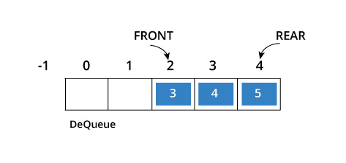
Disadvantage of queue
Circular queue avoids the wastage of space in a regular queue implementation using arrays.

Slide 3
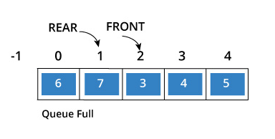
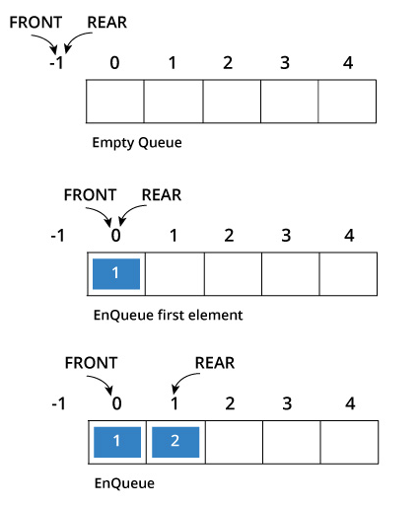
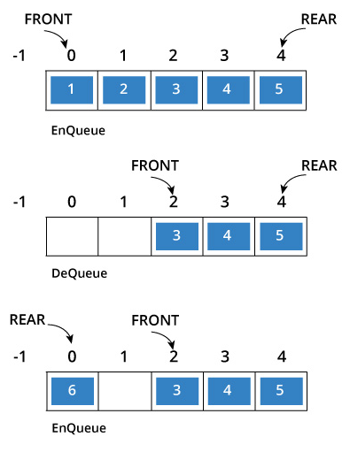
Circular queue

